Slide 1
Computational logic homework
Andrei Cibotariu

Slide 2
Exercise 8
Consider the following set of hypotheses {H1, H2, H3, H4, H5, H6} and check the validity of the conclusion (C) based on the validity of the hypotheses H1, H2, H3, H4, H5, H6. Apply the semantic tableaux method.
H1: Every child loves Santa.
H2: Everyone who loves Santa loves any reindeer.
H3: Rudolph is a reindeer, and Rudolph has a red nose.
H4: Anything which has a red nose is weird or is a clown.
H5: No reindeer is a clown.
H6: Scrooge does not love anything which is weird.
C: Scrooge is not a child.

Slide 3
Theory

Slide 4
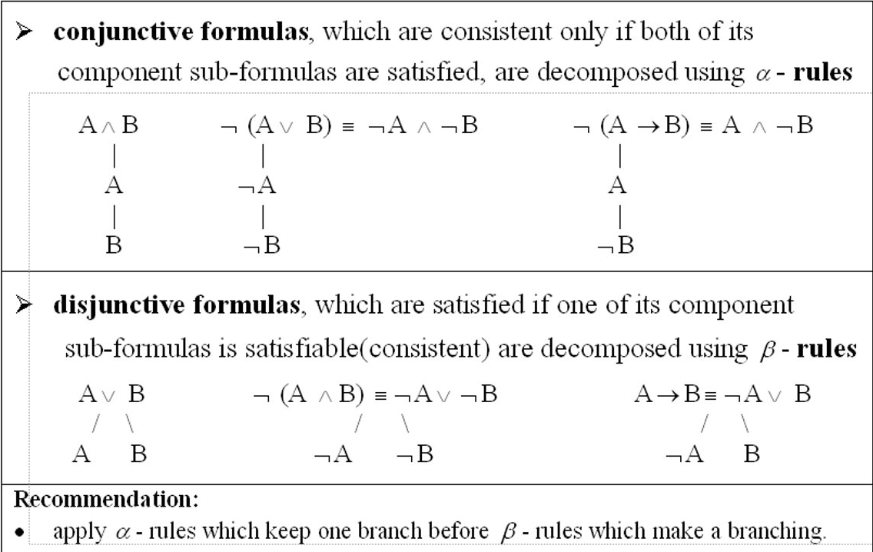
1. Decomposition rules for propositional formulas

Slide 5
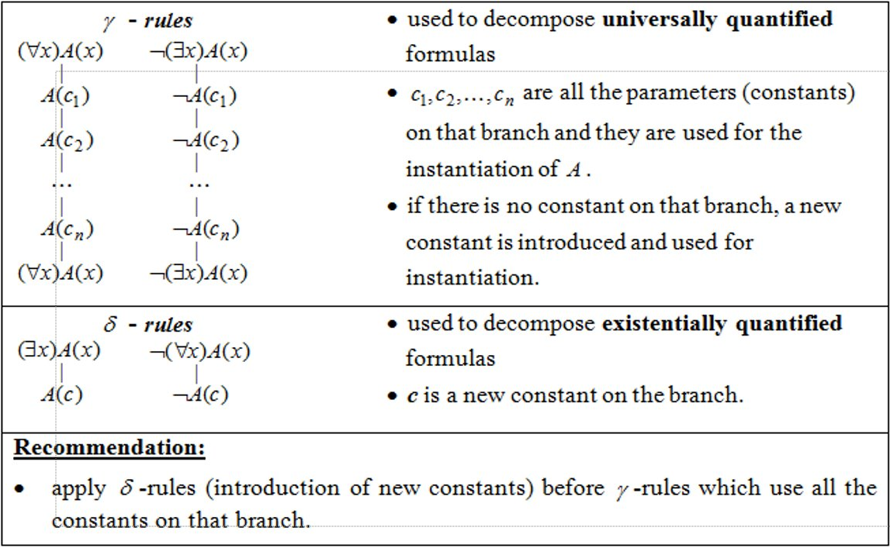

Slide 6
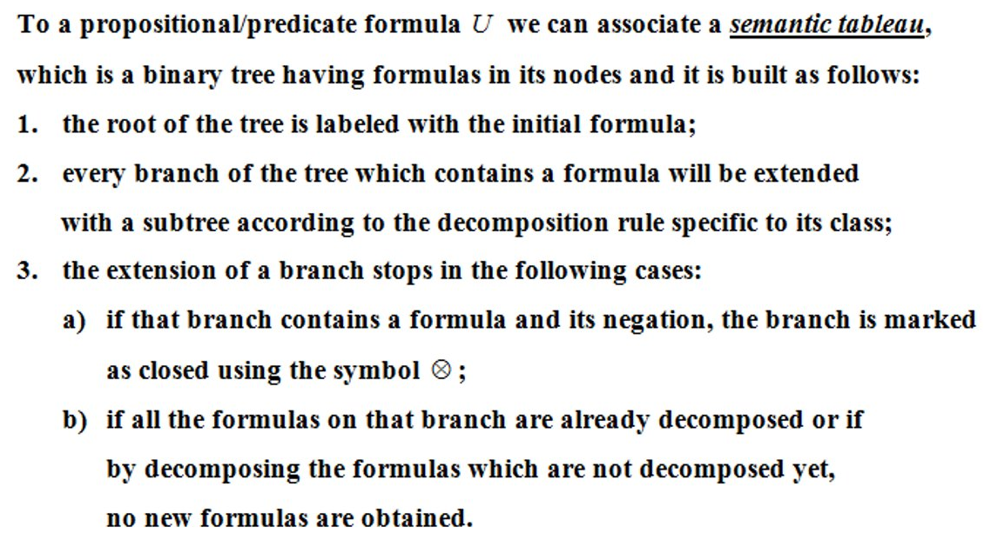
2. Construction of a semantic tableaux

Slide 7
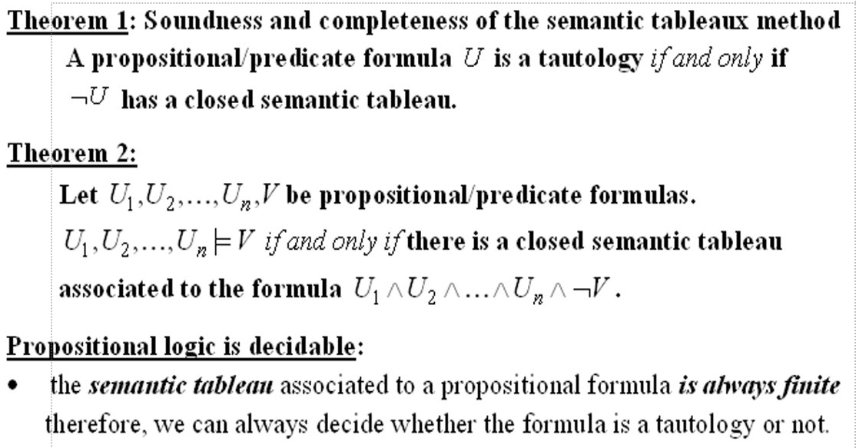
3. theorems

Slide 8
Solution

Slide 9
1. We transform the hypotheses and the conclusion into predicate formulas
Constants: Santa, Rudolph, Scrooge
Domain: D (the universe of living things)
Predicate symbols:
Unary: ch, rd, rn, wd, cn
Binary: lv

Slide 10
2. Defining the predicate formulas
ch : D → {T, F}, ch(x) = T if x is a child
rd : D → {T, F}, rd(x) = T if x is a reindeer
rn : D → {T, F}, rn(x) = T if x has a red nose
wd : D → {T, F}, wd(x) = T if x is weird
cn : D → {T, F}, cn(x) = T if x is a clown
lv : DxD → {T, F}, lv(x, y) = T if x loves y

Slide 11
3. Transforming the hypotheses
H1: ∀x (ch(x) → lv(x, Santa))
H2: ∀x (lv(x, Santa) → ∀y(rd(y) → lv(x, y)))
H3: rd(Rudolph) ˄ rn(Rudolph)
H4: ∀x (rn(x) → (wd(x) ˅ cn(x))
H5: ̚ ∃x(rd(x) ˄ cn(x)) ≡ ∀x (rd(x) → ̚ cn(x))
H6: ∀x (wd(x) → ̚ lv(Scrooge, x))
C: ̚ ch(Scrooge)

Slide 12
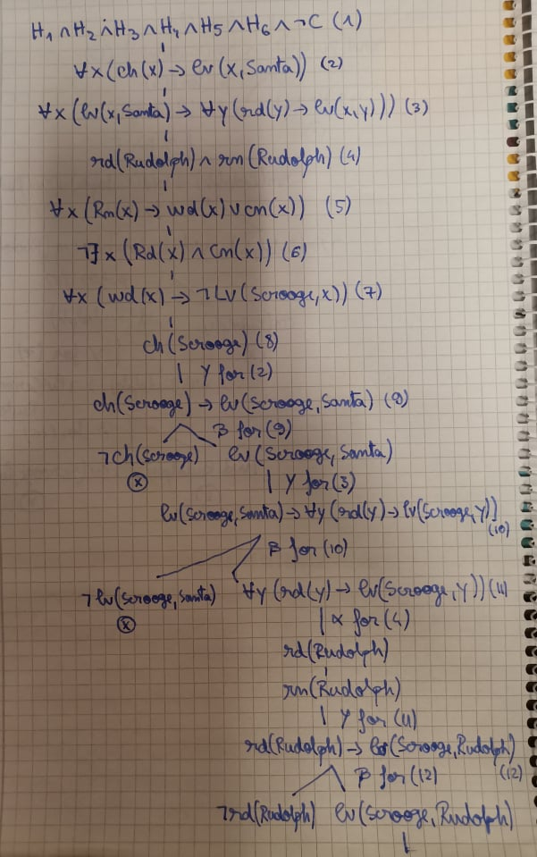
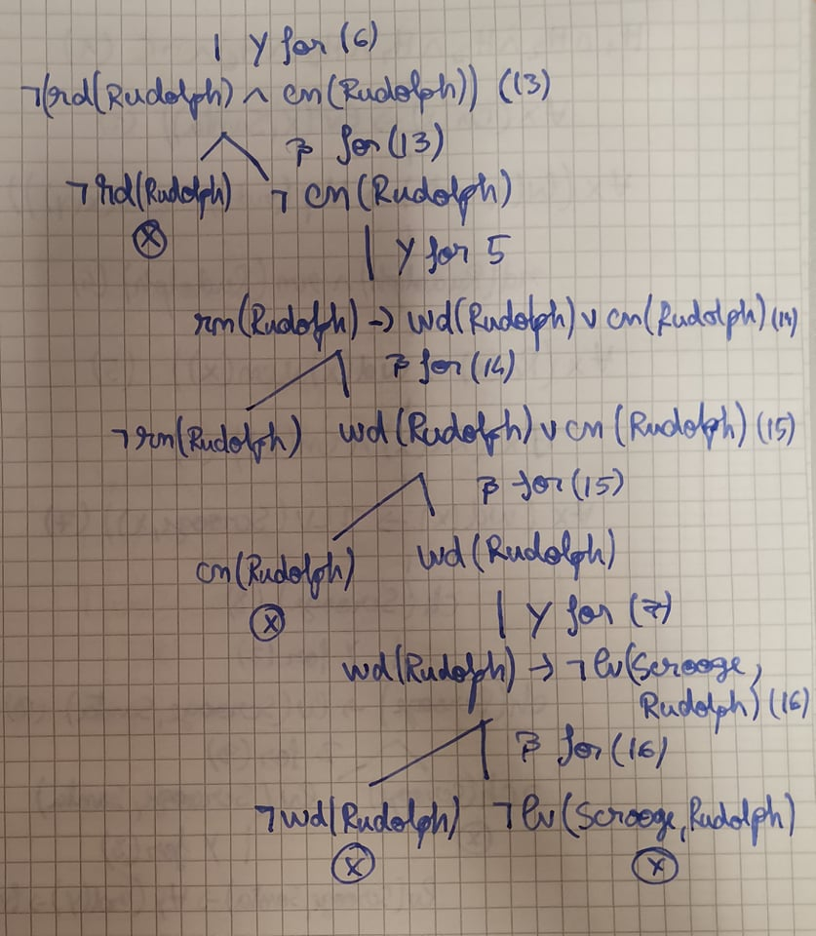
4. Building the tree

Slide 13
5. Conclusion
We have obtained a closed semantic tableaux, so based on the hypotheses, the conclusion is TRUE!

Slide 14
Thank you for your attention!

